Slide 1
Lecture 4
Composite Newton-Cotes Formulas

Slide 2


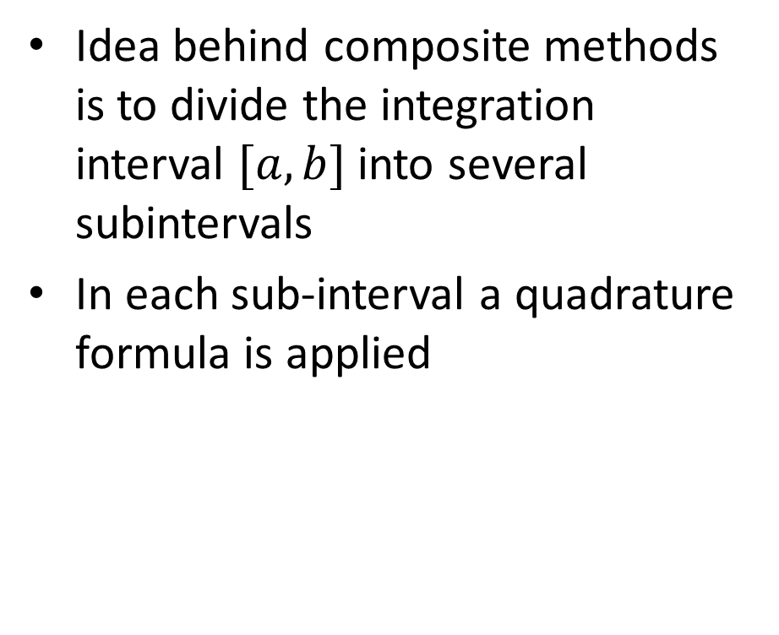

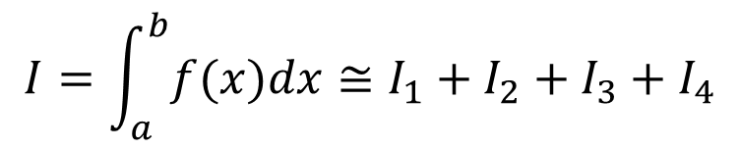






Introduction
Idea behind composite methods is to divide the integration interval $[a,b]$ into several subintervals
In each sub-interval a quadrature formula is applied
$$y=f(x)$$
$$y$$
$$I_{1}$$
$$I_{2}$$
$$I_{3}$$
$$I_{4}$$
$$I=\int_{a}^{b}{f(x)dx}≅I_{1}+I_{2}+I_{3}+I_{4}$$
$$x$$
$$a$$
$$d_{1}$$
$$d_{2}$$
$$d_{3}$$
$$b$$
Notes:
In this lecture we will discuss the composite version of the trapezoid and Simpson 1/3 rules
The idea behind composite methods is to divide the integration interval $[a,b]$ into several subintervals
In the example on the slide we divided the interval into four segments
After division, a quadrature formula is applied in each sub-interval
The integral is then approximated by summing the results of the various quadrature formulas on the sub-intervals

Slide 3




















How to choose sub-intervals
Based on the plot of the function
Subdividing into $m$ equally sized subintervals
Composite Newton-Cotes formulas
$$y$$
$$y$$
$$y=f(x)$$
$$y=f(x)$$
$$I_{1}$$
$$I_{2}$$
$$I_{3}$$
$$I_{4}$$
$$I_{5}$$
$$I_{1}$$
$$I_{2}$$
$$I_{i}$$
$$I_{m}$$
$$a$$
$$b$$
$$x$$
$$a$$
$$b$$
$$x$$
Notes:
How do we choose the way to subdivide the integration interval into sub-intervals?
A first way is to plot the function to be integrated and choose accordingly
In the example on the slide the intervals were chosen such that the function over the sub-intervals is as simple as possible
For example almost linear or very close to a quadratic function
This way the application of the trapezoid and Simpson 1/3 rule will become very accurate
A second approach, which is the approach we will follow, is to subdivide the integration interval into m equally spaced intervals.
In this case one obtains the so-called composite Newton-Cotes formulas

Slide 4

















Composite Trapezoid Rule
In each sub-interval we apply the trapezoidal rule
Example:
$$I_{3}≅\left(x_{3}−x_{2}\right)\frac{f\left(x_{2}\right)+f\left(x_{3}\right)}{2}$$
$$I≅\frac{h}{2}\left(f\left(a\right)+f\left(b\right)+2\sum_{i=1}^{m−1}{f\left(x_{i}\right)}\right)$$
$$y$$
$$y=f(x)$$
$$h\text{ (}\text{c}\text{alled}\text{: }\text{step} \text{size}\text{)}$$
$$I_{3}$$
$$I_{4}$$
$$I_{2}$$
$$I_{1}$$
$$x_{1}$$
$$x_{2}$$
$$x_{3}$$
$$x$$
$$a$$
$${=x}_{0}$$
$$b$$
$${=x}_{4}$$
$$h$$
Notes:
Let us start by developing the composite trapezoid rule
We start by dividing the integration interval into m equally spaced sub-intervals
In the example of the slide we divvied the integration interval into four sub-intervals
In each sub-interval we apply the trapezoidal rule
For this we add the two interpolations points in each sub-interval which are start and end points of each sub-interval
Once the interpolation points defined, we interpolate them with a first degree polynomial
The surface below these interpolating polynomials give the approximations I1, I2, I3 and I4 of the defined integral we look for
Let us now number the interpolation points starting with x0 to the last one which is x4 in our case
We can then compute the various integrals over the sub-intervals using the trapezoid rule
For example, for I3 we can calculate it as $\left(x_{3}−x_{2}\right)\frac{f\left(x_{2}\right)+f\left(x_{3}\right)}{2}$
Note that $x_{3}−x_{2}$ is equal to h, which will refer to in future as the step size
Once we computed all these sub-integrals we can sum them to get the approximation of our defined integral
When you perform hand calculations this is the method I recommend you to use
If you want to implement the method in a computer it is useful to write down the composite method as an explicit formula:
$$I≅\frac{h}{2}\left(f\left(a\right)+f\left(b\right)+2\sum_{i=1}^{m−1}{f\left(x_{i}\right)}\right)$$
It is easy to prove this formula
I invite you to write down the expressions for I1, I2, I3 and I4 for the example on the slide and then sum them all.
It will become clear why the composite formula is correct

Slide 5






















Composite Simpson’s Rule
In each sub-interval we apply Simpson's 1/3 rule
Example:
$$I_{3}≅\frac{x_{6}−x_{4}}{6}\left[f\left(x_{4}\right)+4f\left(\frac{x_{4}+x_{6}}{2}\right)+f\left(x_{6}\right)\right]$$
$$I≅\frac{h}{3}\left(f\left(a\right)+f\left(b\right)+4\sum_{i=1}^{m}{f\left(x_{2i−1}\right)}+2\sum_{i=1}^{m−1}{f\left(x_{2i}\right)}\right)$$
$$y$$
$$y=f(x)$$
$$2h$$
$$x_{5}$$
$$I_{3}$$
$$I_{4}$$
$$I_{2}$$
$$I_{1}$$
$$x_{1}$$
$$x_{2}$$
$$x_{3}$$
$$x_{4}$$
$$x_{5}$$
$$x_{6}$$
$$x_{7}$$
$$x$$
$$a$$
$${=x}_{0}$$
$$b$$
$${=x}_{8}$$
$$h$$
Notes:
In same way we can proceed with the Simpson 1/3 rule
We start by dividing the integration interval into m equally spaced sub-intervals
In the example of the slide we divvied the integration interval into four sub-intervals
In each sub-interval we apply the Simpson 1/3 rule
For this we add the three interpolations points in each sub-interval which are start , mid and end points of each sub-interval
Once the interpolation points are defined, we interpolate them with a second degree polynomial
The surface below these interpolating polynomials give the approximations I1, I2, I3 and I4 of the defined integral we look for
Let us now number the interpolation points starting with x0 to the last one which is x8 in our case
We can now compute various integrals over the sub-intervals using the trapezoid rule
For example, for I3 we can calculate it as
$\frac{x_{6}−x_{4}}{6}\left[f\left(x_{4}\right)+4f\left(\frac{x_{4}+x_{6}}{2}\right)+f\left(x_{6}\right)\right]$
Note that $x_{6}−x_{4}$ is equal to 2h, if we define h as being the distance between two consecutive interpolating points
Further $\frac{x_{4}+x_{6}}{2}$ is nothing else than $x_{5}$
Once we computed all these sub-integrals we can sum them to get the approximation of our defined integral
When you perform hand calculations this is the method I recommend you to use
If you want to implement the method in a computer it is useful to write down the composite method as an explicit formula as displayed on the slide
Note that this formula isn’t very handy when you do hand calculations and it is very easy to make mistakes.
That is why I strongly recommend you, if you do hand calculations, to compute individually the integrals over each sub-interval and afterwards sum them
To prove this formula I invite you to write down the expressions for I1, I2, I3 and I4 for the example on the slide and then sum them all.
It will become clear why the composite formula is correct

Slide 6
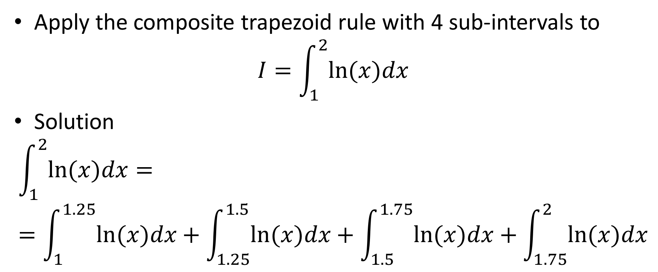
Example
Apply the composite trapezoid rule with 4 sub-intervals to
$$I=\int_{1}^{2}{ln⁡(x)dx}$$
Solution
$$\int_{1}^{2}{ln⁡(x)dx}==\int_{1}^{1.25}{ln⁡(x)dx}+\int_{1.25}^{1.5}{ln⁡(x)dx}+\int_{1.5}^{1.75}{ln⁡(x)dx}+\int_{1.75}^{2}{ln⁡(x)dx}$$
Notes:
Let us now apply our quadrature formula to an example
For this we compute the defined integral of the natural log function over the interval [1, 2]
We want to use the trapezoid composite method with 4 sub-intervals
For this we split the defined integral into the sum over four integrals

Slide 7
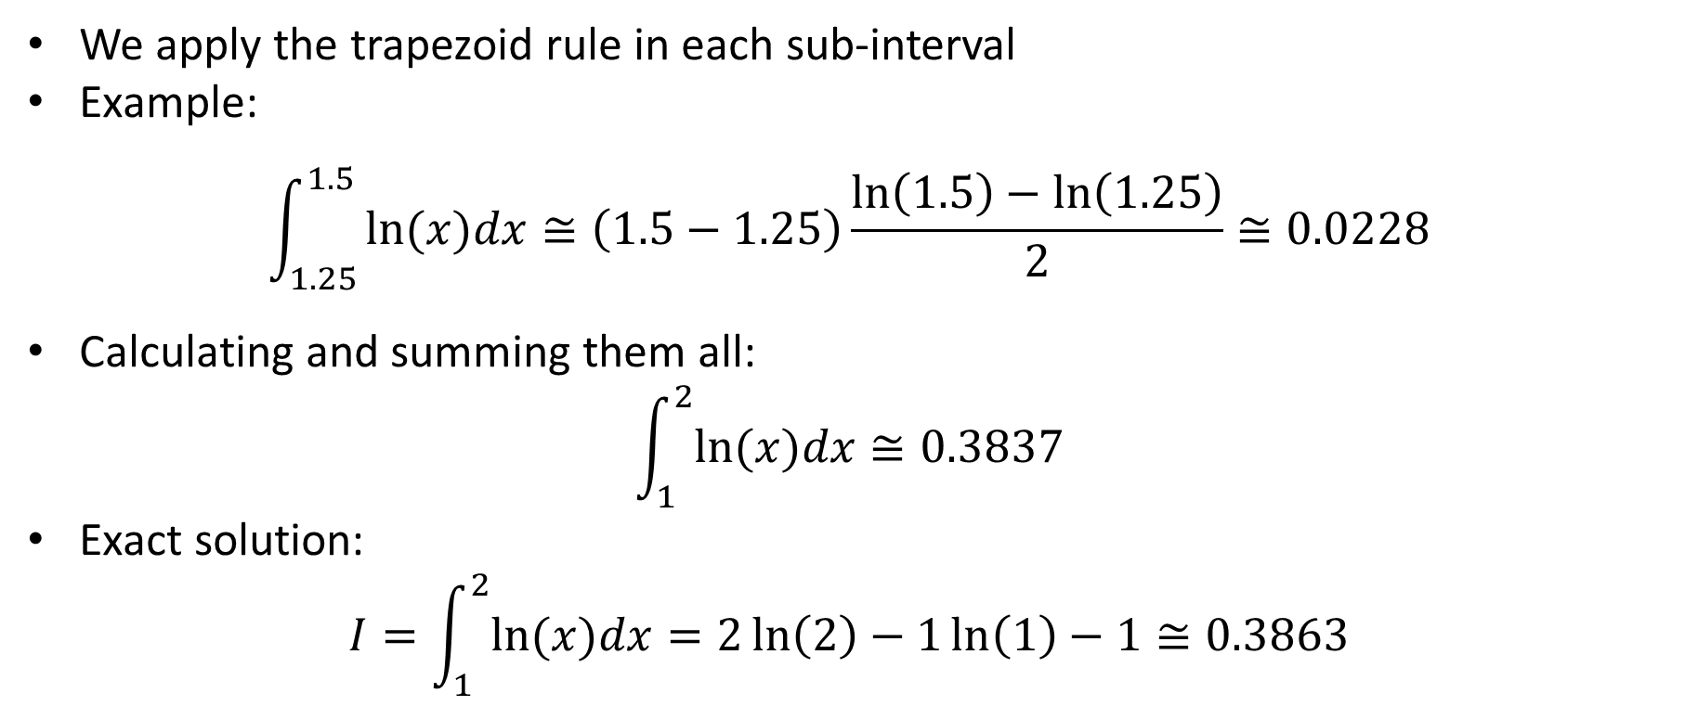
Example
We apply the trapezoid rule in each sub-interval
Example:
$$\int_{1.25}^{1.5}{ln⁡(x)dx≅\left(1.5−1.25\right)\frac{\ln\left(1.5\right)−\ln\left(1.25\right)}{2}≅0.0228}$$
Calculating and summing them all:
$$\int_{1}^{2}{ln⁡(x)dx≅0.3837}$$
Exact solution:
$$I=\int_{1}^{2}{ln⁡(x)dx}=2\ln\left(2\right)−1\ln\left(1\right)−1≅0.3863$$
Notes:
After splitting the calculations over 4 sub-intervals we apply in each of them the trapezoid rule
For example for the sub-interval [1.25, 1.5] we obtain a value of $0.0228$ if we use 4 significant digits
After computing them all and summing them we obtain $0.3837$
I invite you to perform these calculations and check you get the right answer
We can compare this approximation with the exact value 0.3863 we get by using calculus.
Note that both values are remarkably close.
I invite you as well to repeat these calculations using the Simpson 1/3 rule
You should find a value of 0.38629 if you use 5 digits in your calculations

Slide 8
Using Octave / Matlab
Composite Trapezoid Rule
Composite Simpson 1/3 rule
>> a=1; b=2;
>> f = @(x) log(x)
>> m = 4;
>> x=linspace(a,b,m+1);
>> h=(b-a)/m;
>> I=h/2*(2*sum(f(x)) - f(a)-f(b))
I = 0.38370
>> a=1; b=2;
>> f = @(x) log(x)
>> m = 4;
>> h=(b-a)/(2*m);
>> x1=linspace(a+h,b-h,m);
>> x2=linspace(a+2*h,b-2*h,m-1);
>> I=h/3*(f(a)+f(b)+4*sum(f(x1))+2*sum(f(x2)))
I = 0.38629
Notes:
Before finishing this lecture on composite methods, let me show you a way to implement them into Octave or Matlab
It is of course not the only way. You may want to try other possibilities by yourself
Let us start with the trapezoid rule
We first define two variables a and b as our start and end point of the integration interval
We then define the function we would like to integrate.
In our example we use the natural logarithm
Then we define the variable m as the number of sub-intervals we want to use
As next step we create a vector x with the interpolating points
For this we use the command linsapce.
This command takes three parameters as input.
The first is the start point, the second the end point and the third is the number of points to generate between start and end points
The points will be uniformly distributed between start and end points
The start and end points are included
For the trapezoid rule with m sub-intervals we will need m+1 interpolating points
We further define h as the distance between the interpolating points, which is (b-a)/m
With all this elements we can compute the approximation of the defined integral over the interval [a,b]
This is done by summing all values of f(x) in the various interpolating points.
We need to subtract f(a) and f(b) as we have counted them too much in our summation
In our example we get 0.38370
We can proceed similarly for the Simpson 1/3 rule
We first define two variables a and b as our start and end point of the integration interval
We then define the function we would like to integrate.
Then we define the variable m as the number of sub-intervals we want to use
We further define h as the distance between the interpolating points, which is (b-a)/(2*m)
As next step we create two vectors x1 and x2 with the interpolating points, not including the start and end points a and b
X1 will contain the interpolating points with odd index
X2 will contain the interpolating points with even index
With all this elements we can compute the approximation of the defined integral over the interval [a,b]
This is done by summing all values of f(x) in the various interpolating points with the appropriate weights
In our example we get 0.38629
Based on these two code examples I invite you to write your own scripts to integrate functions with the composite methods

Slide 9
Summary
Quadrature formulas can be combined by subdividing the integration interval into sub-intervals
In each sub-interval a quadrature formula is used
Making equally spaced sub-intervals result in Newton-Cote composite methods
We discussed the application of the trapezoid and Simpson composite methods
Notes:
Let us summarize the key findings
- Quadrature formulas can be combined by subdividing the integration interval into sub-intervals
- In each sub-interval a quadrature formula is used
- Making equally spaced sub-intervals result in Newton-Cote composite methods
- We discussed the application of the trapezoid and Simpson composite methods

